Slide 1

Reconocimiento de Patrones
Domingo Mery
Departmento de Ciencia de la Computación
Escuela de Ingeniería
Universidad Católica de Chile
Definiciones
[ Capítulo 1 ]

Slide 2


Imágenes Digitales

Slide 3


Imágenes Digitales (zoom)

Slide 4
Imágenes Digitales (coordenadas)
y
y
x = 639
y = 599
size: 686 x 1029 pixels
x
x

Slide 5


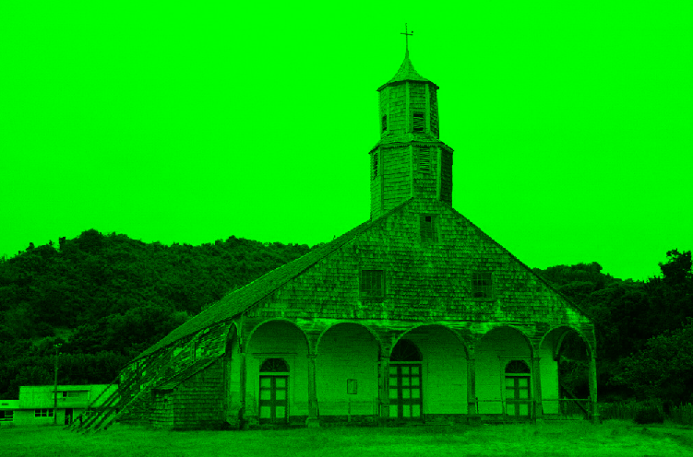
Imágenes Digitales (color)
R = 200 G = 127 B = 45

Slide 6
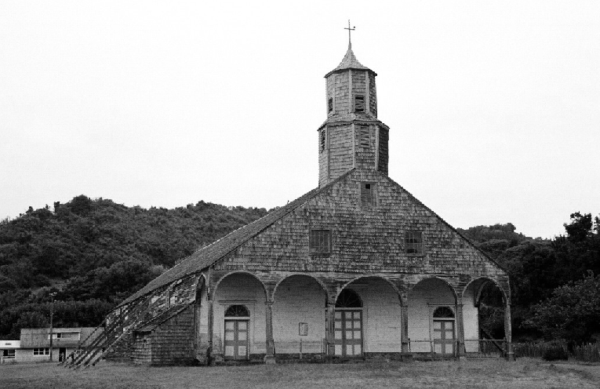
Imágenes Digitales (color a blanco y negro)
I = (R + G + B) / 3

Slide 7

Imágenes Digitales (tonos de gris)
1 128 256
0
255

Slide 8
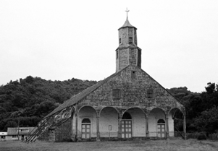
Imágenes Digitales (operaciones)
I
I x 0.5
I x 2

Slide 9

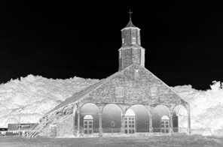
Imágenes Digitales (operaciones)
I
I > 200
256-I

Slide 10
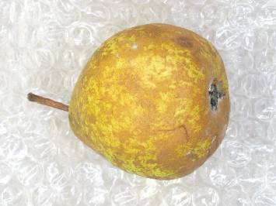

Image Processing:
The use of computer algorithms that take an image as input and return an image as output.
[ INPUT ] [ OUTPUT ]

Slide 11
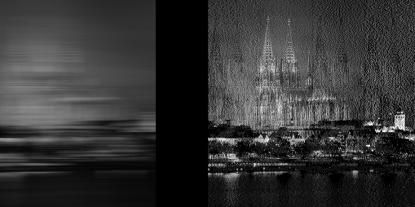
Image Processing:
The use of computer algorithms that take an image as input and return an image as output.
[ INPUT ]

Slide 12
Image Processing:
The use of computer algorithms that take an image as input and return an image as output.
[ INPUT ] [ OUTPUT ]

Slide 13
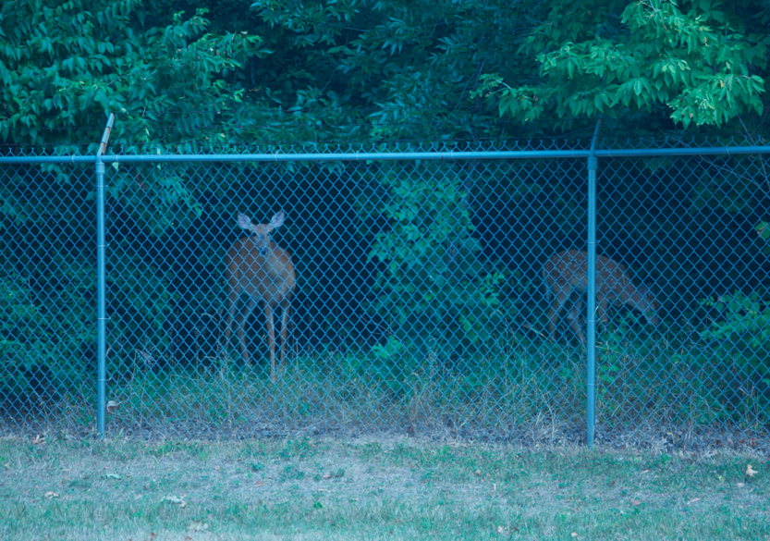
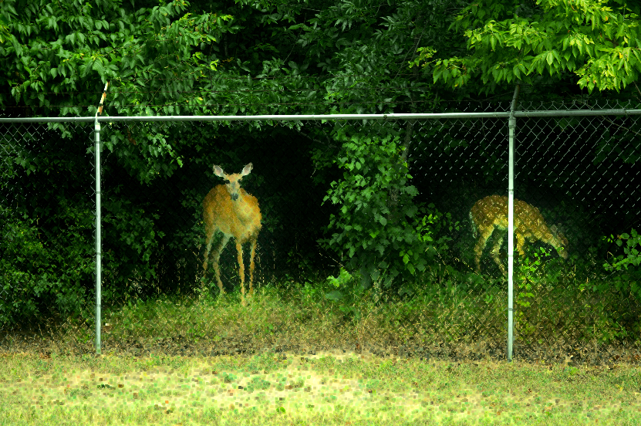
Image Processing:
The use of computer algorithms that take an image as input and return an image as output.
[ INPUT ] [ OUTPUT ]

Slide 16
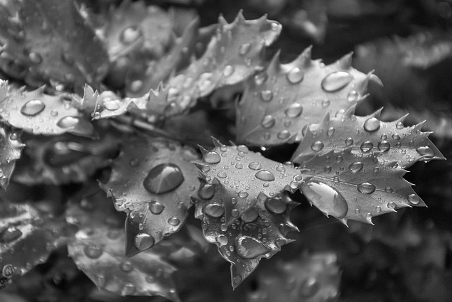
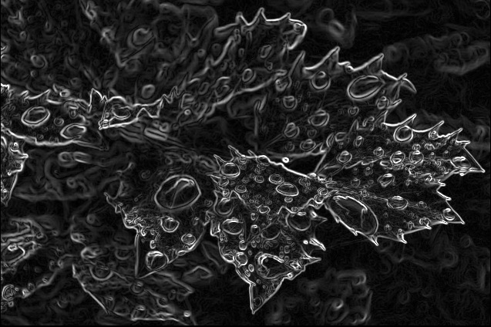
Image Processing:
The use of computer algorithms that take an image as input and return an image as output.
[ INPUT ] [ OUTPUT ]

Slide 18
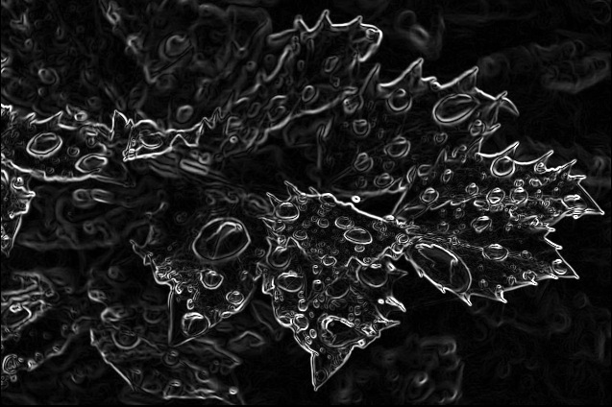

Slide 19
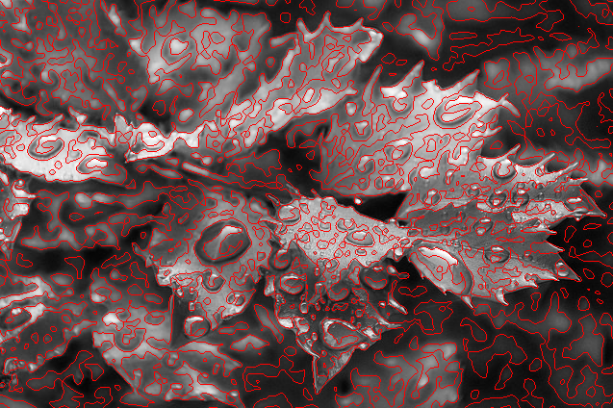

Slide 20
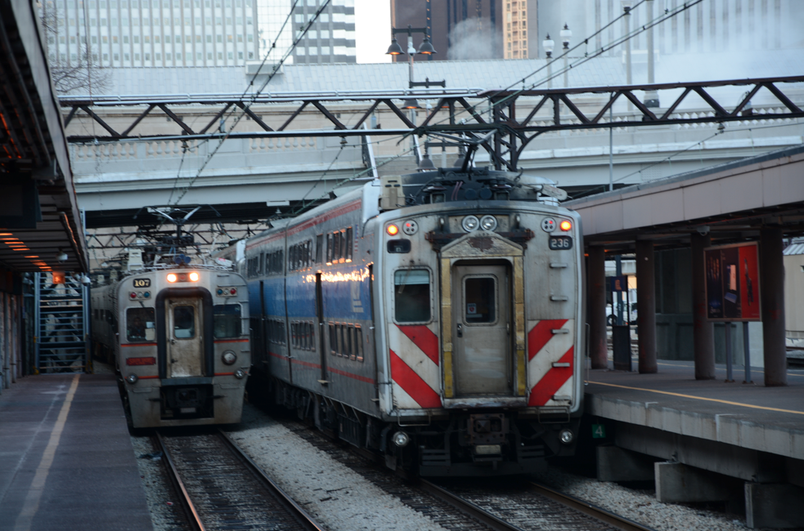
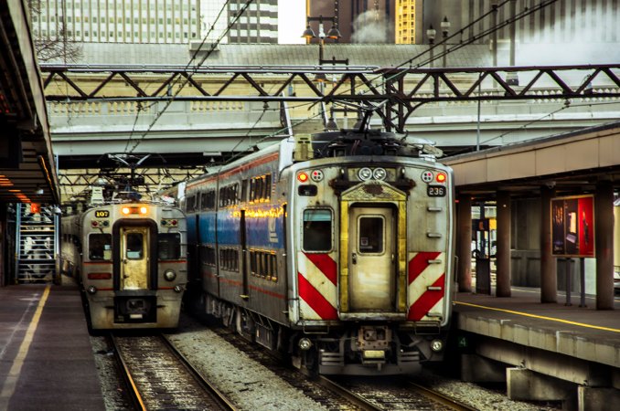
Image Processing:
The use of computer algorithms that take an image as input and return an image as output.
[ INPUT ] [ OUTPUT ]

Slide 23
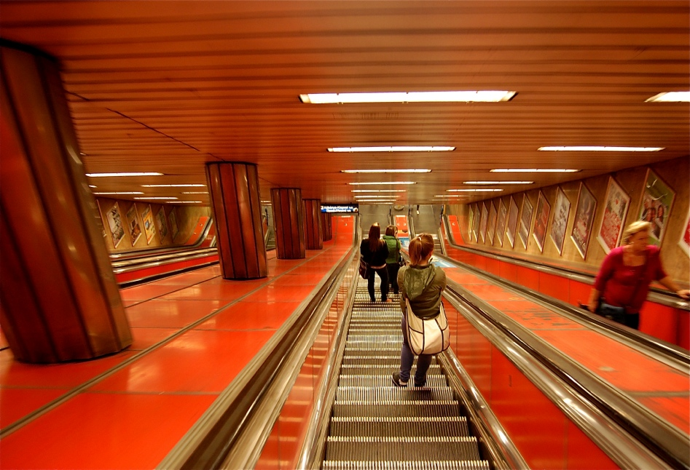
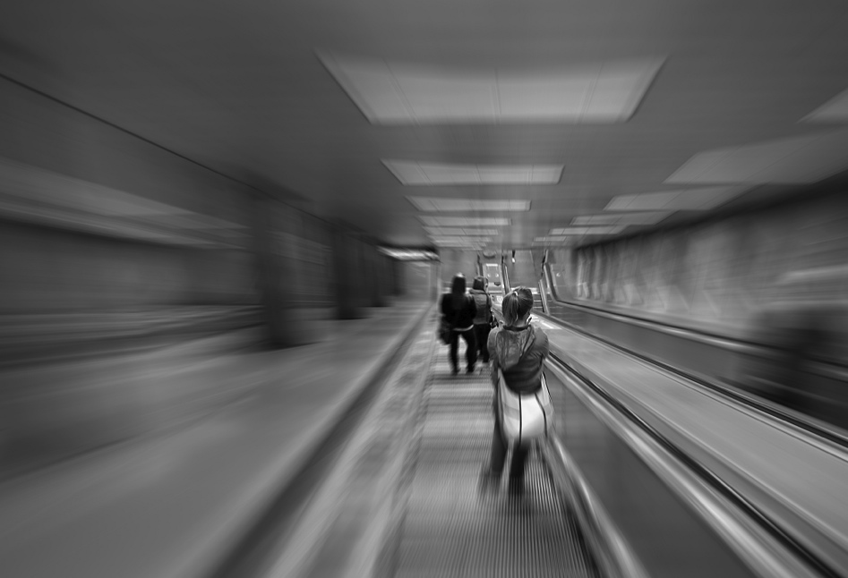
Image Processing:
The use of computer algorithms that take an image as input and return an image as output.
[ INPUT ] [ OUTPUT ]

Slide 24
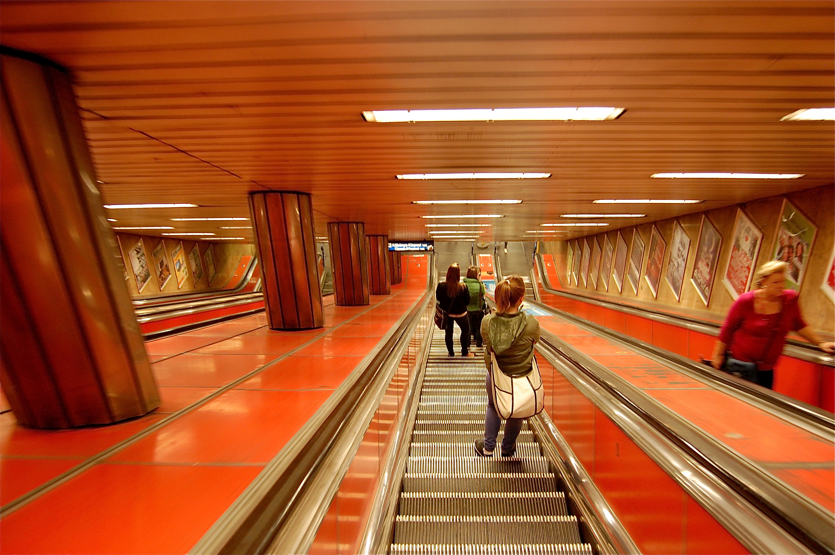

Slide 25
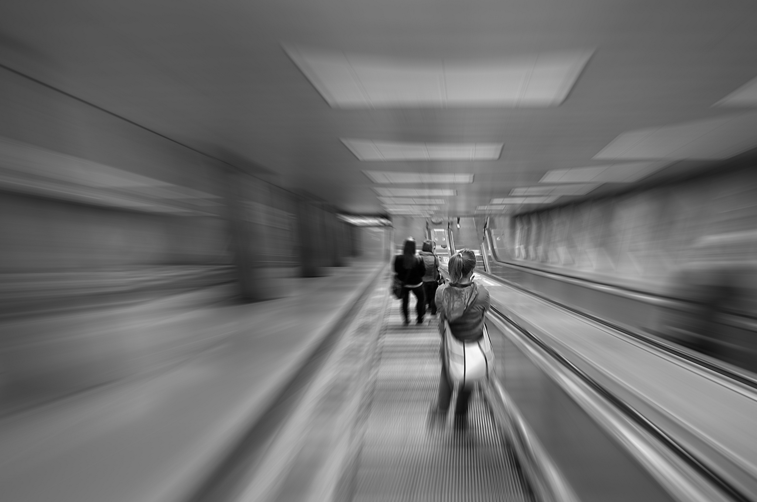

Slide 26
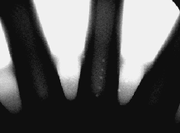
Image Analysis:
The use of computer algorithms that take an image as input and return a measurement, an interpretation or a decision.
The wheel has 7 defects

Slide 27
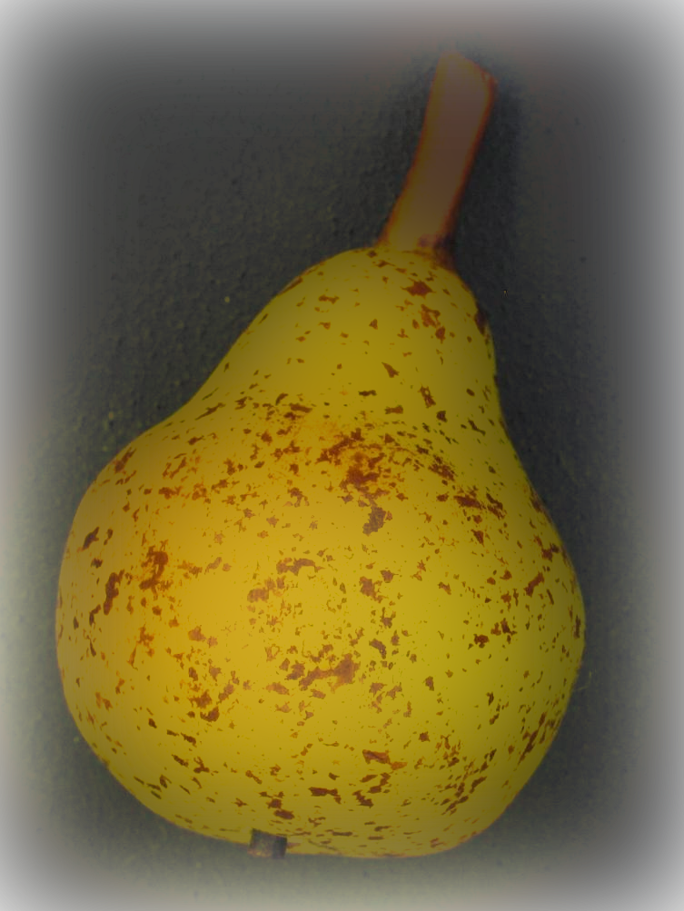


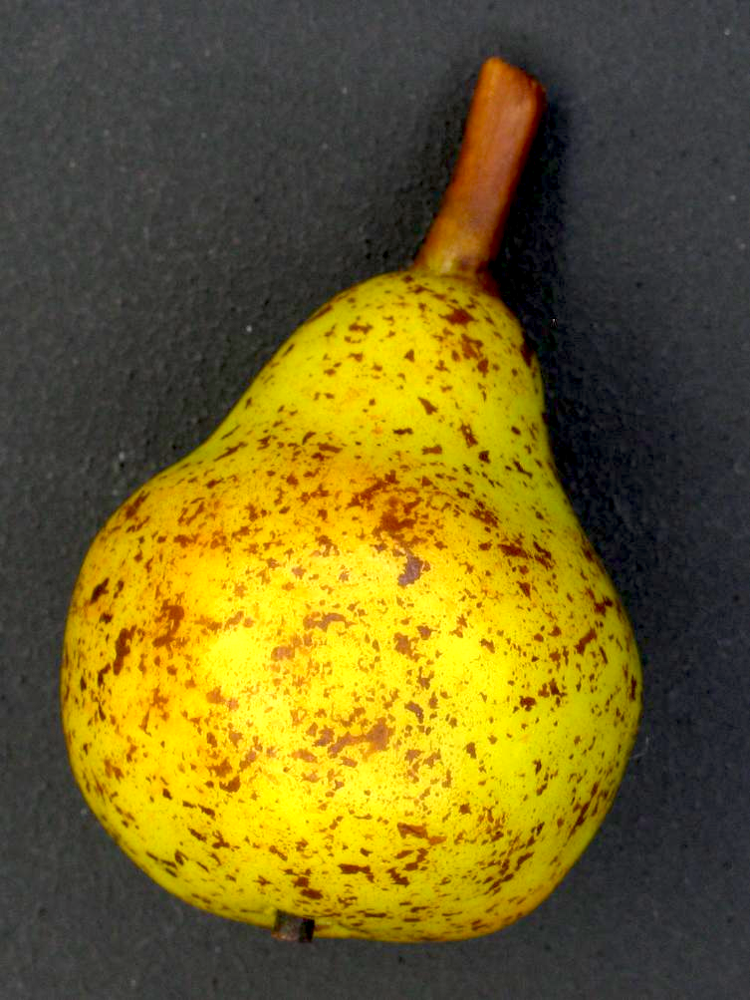
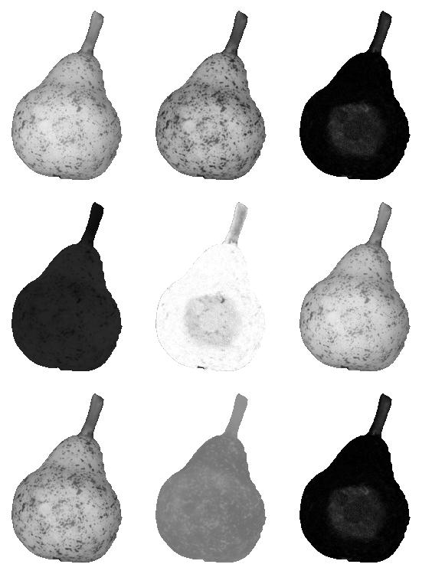
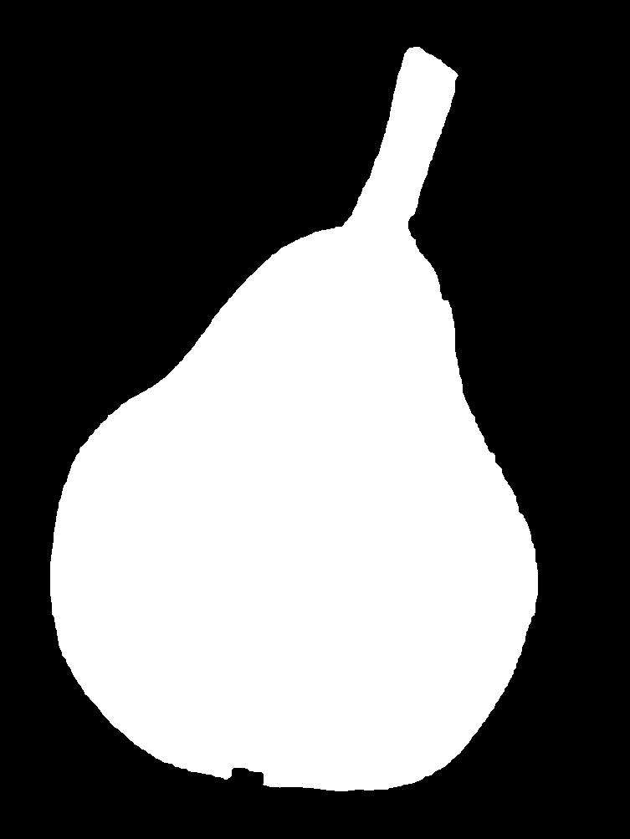
1. Image Acqusition
2. Preprocessing
3. Segmentation
R G B
color
geometry
4. Feature
Extraction
H S V
Feature | Value
Intensity (Yellow) | 0.9875
# spots | 542
: | :
5. Clasification
L* a* b*
“premium”

Slide 28
Pattern Recognition:
It is the science of making inferences based on data. Usually, it measures an object in order to assign it to a class.
HEARTBEAT = 165 bpm
AGE = 45 year
ALARM = ON
SEX = F

Slide 29
1. Image Acqusition
2. Preprocessing
3. Segmentation
R G B
color
geometry
4. Feature
Extraction
4. Feature
Extraction
H S V
Feature | Value
Intensity (Yellow) | 0.9875
# spots | 542
: | :
Pattern Recognition:
5. Clasification
L* a* b*
“premium”

Slide 30
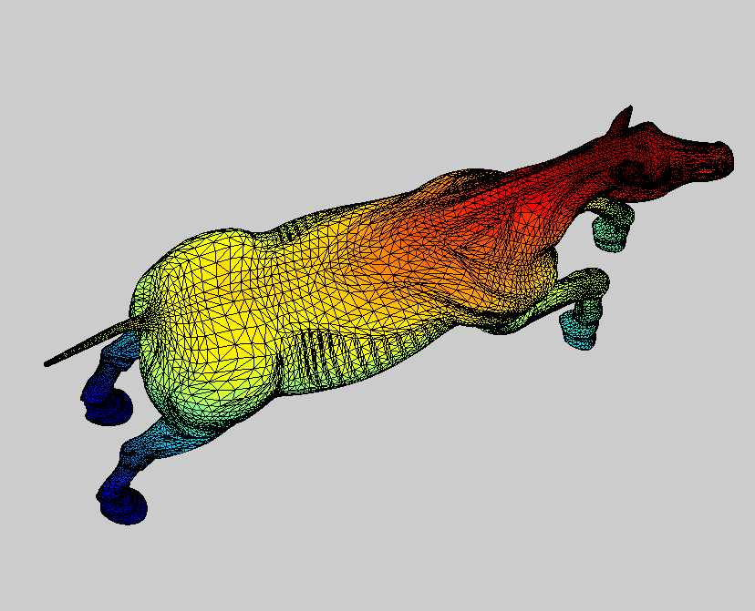
Computer Graphics:
The use of computer algorithms to generate images from models (3D objects, texture, color, illumination, etc.).
© Iván Sipirán
Notes:
Generation of 3D meshes > blackboard

Slide 31
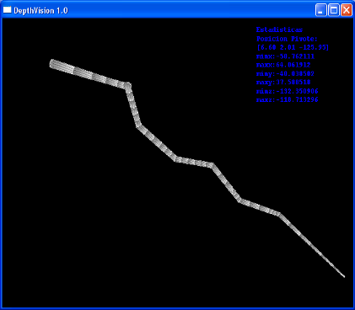
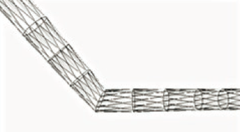

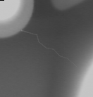
Computer Graphics:
The use of computer algorithms to generate images from models (3D objects, texture, color, illumination, etc.).
Depth map
Simulation
3D mesh
Mery, D.; Hahn, D.; Hitschfeld N. (2005): Simulation of Defects in Aluminium Castings Using CAD Models of Flaws and Real X-ray Images. Insight, 47(10):618-624. [ PDF ]

Slide 32

Computer Graphics:
The use of computer algorithms to generate images from models (3D objects, texture, color, illumination, etc.).

Slide 33
Computer Vision:
Computer vision is the science of endowing computers the ability to see. [ Faugeras ]
Notes:
What do you think? Can a computer see?
We will leave the definition as it is, and strive to endow computer vision systems with as many capabilities as we can rather than dwelling on whether we have built a system that can truly see.

Slide 34
Computer Vision:
Computer vision is the science of endowing computers the ability to see. [ Faugeras ]
Computer vision is a field that includes methods for acquiring, processing, analyzing, and understanding images and, in general, high-dimensional data from the real world in order to produce numerical or symbolic information, e.g., in the forms of decisions. [ wikipedia ]
Notes:
What do you think? Can a computer see?
We will leave the definition as it is, and strive to endow computer vision systems with as many capabilities as we can rather than dwelling on whether we have built a system that can truly see.

Slide 35
Computer Vision System:
Object
Image
Acquisition
Image
Processing
Image
Analysis
Photography
X rays
Thermography
Restoration
Filtering
Segmentation
Feature extraction
Feature selection
Machine Learning
Classification
Measurements
Interpretation

Slide 36
Computer Vision System:
Object
Image
Acquisition
Image
Processing
Image
Analysis
Multi-view
Analysis
Decision
Photography
X rays
Thermography
Restoration
Filtering
Segmentation
Feature extraction
Feature selection
Machine Learning
Classification
Measurements
Interpretation
Matching
Tracking
3D reconstruction
Calibration
knowledge base
(optional)

